Slide 1
Design Thinking
Introduction
https://www.nngroup.com/articles/design-thinking/
[...Bjørn H. Westh] TID 30-8-2022, ITU CPH

Slide 2
The Why & When
do we use it?
[...Bjørn H. Westh] TID 30-8-2022, ITU CPH

Slide 3
design thinking/why & when
Puzzle
One correct solution
Finite amount of information
All information should be used
[...Bjørn H. Westh] TID 30-8-2022, ITU CPH

Slide 4
design thinking/why & when
Puzzle
Problem
One correct solution
Finite amount of information
All information should be used
Multiple solutions
Lot of superfluous information
Possibly insoluble
[...Bjørn H. Westh] TID 30-8-2022, ITU CPH

Slide 5
design thinking/why & when
Puzzle
Problem
Wicked problem
One correct solution
Finite amount of information
All information should be used
Multiple solutions
Lot of superfluous information
Possibly insoluble
Unique
No formula
Non-enumerable
No stopping rule
Not immediately testable
Multiple perspectives
[...Bjørn H. Westh] TID 30-8-2022, ITU CPH

Slide 6
design thinking/why & when
Wicked problem
There is no definitive formula for a wicked problem.
Wicked problems have no stopping rule—there’s no way to know whether your solution is final.
Solutions to wicked problems are not true or false (right or wrong); they can only be good or bad.
You cannot immediately test a solution to a wicked problem.
Every solution to a wicked problem is a “one-shot operation” because there is no opportunity to learn by trial and error—every attempt counts significantly.
Wicked problems do not have a set number of potential solutions.
Every wicked problem is essentially unique.
Every wicked problem can be considered a symptom of another problem.
There is always more than one explanation for a wicked problem because the explanations vary greatly depending on the individual’s perspective.
The planner/designer has no right to be wrong and must be fully responsible for their actions.
https://www.interaction-design.org/
[...Bjørn H. Westh] TID 30-8-2022, ITU CPH

Slide 7
The Principles
theory condensed
[...Bjørn H. Westh] TID 30-8-2022, ITU CPH

Slide 8
design thinking/principles
Human-centric
Ambiguity
Redesign
Tangibility
[...Bjørn H. Westh] TID 30-8-2022, ITU CPH

Slide 9
design thinking/principles
Human-centric
Ambiguity
Redesign
Tangibility
Design should be human-centric
Designing is inherently a social activity.
“People ignore design that ignores people.” - Frank Chimero.
[...Bjørn H. Westh] TID 30-8-2022, ITU CPH

Slide 10
design thinking/principles
Human-centric
Ambiguity
Redesign
Tangibility
Design is ambiguous, embrace it
Many different (possibly equal) solutions
Experiment with completely different approaches
[...Bjørn H. Westh] TID 30-8-2022, ITU CPH

Slide 11
design thinking/principles
Human-centric
Ambiguity
Redesign
Tangibility
All design is redesign
Context changes - Humans do not
Did someone already solve part of your problem? Re-use!
[...Bjørn H. Westh] TID 30-8-2022, ITU CPH

Slide 12
design thinking/principles
Human-centric
Ambiguity
Redesign
Tangibility
Make design tangible early
Prototypes big and small help you communicate and test
[...Bjørn H. Westh] TID 30-8-2022, ITU CPH

Slide 13
The Process
to follow
[...Bjørn H. Westh] TID 30-8-2022, ITU CPH

Slide 14
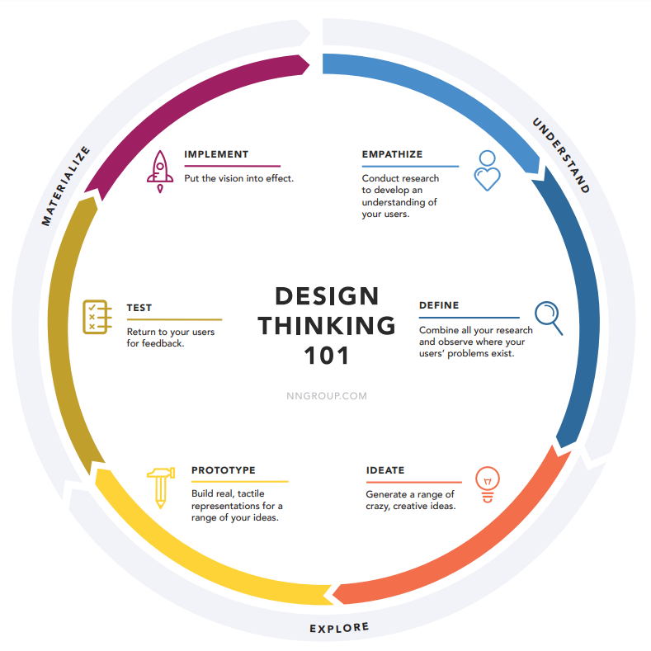
design thinking/process
https://media.nngroup.com/media/articles/attachments/Design-thinking-101-NNG.pdf
[...Bjørn H. Westh] TID 30-8-2022, ITU CPH

Slide 15
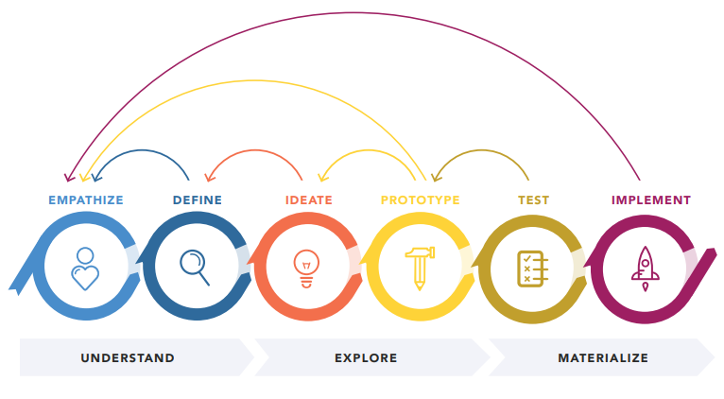
design thinking/process
https://media.nngroup.com/media/articles/attachments/Design-thinking-101-NNG.pdf
[...Bjørn H. Westh] TID 30-8-2022, ITU CPH

Slide 16
The How
do we do it then?
[...Bjørn H. Westh] TID 30-8-2022, ITU CPH

Slide 17
design thinking/the how
https://media.nngroup.com/media/articles/attachments/Design-thinking-101-NNG.pdf
[...Bjørn H. Westh] TID 30-8-2022, ITU CPH

Slide 18
design thinking/the how
https://media.nngroup.com/media/articles/attachments/Design-thinking-101-NNG.pdf
[...Bjørn H. Westh] TID 30-8-2022, ITU CPH

Slide 19
WHAT IS EMPATHY?

Slide 20
design thinking/the how
Professional Empathy
Perspective taking
Staying out of judgement
Recognising emotion
Communicating the above
For more see: Theresa Wiseman or watch this very cute video: https://www.youtube.com/watch?v=1Evwgu369Jw&t=131s&ab_channel=RSA
[...Bjørn H. Westh] TID 30-8-2022, ITU CPH

Slide 21
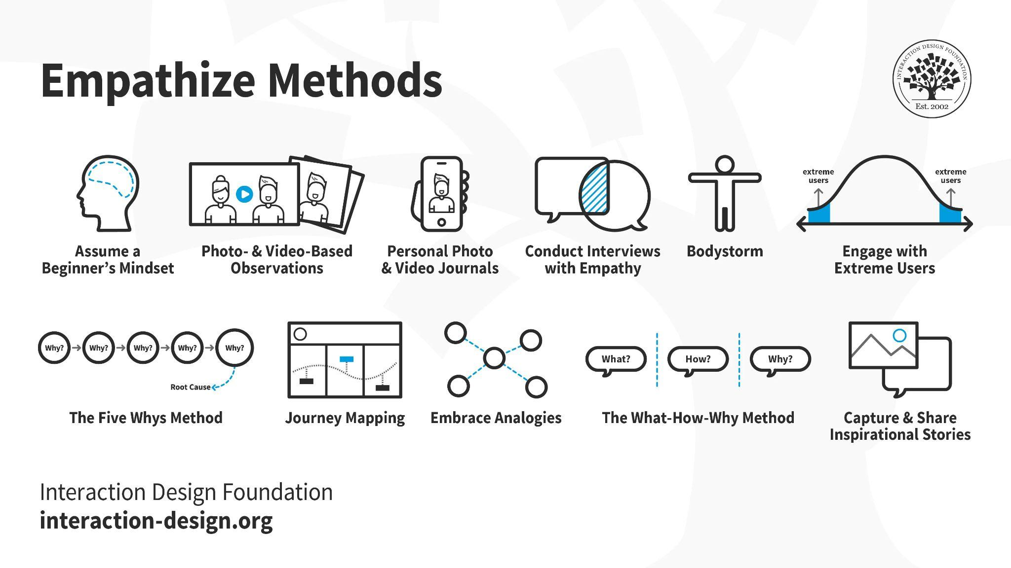
design thinking/the how
[...Bjørn H. Westh] TID 30-8-2022, ITU CPH

